Slide 1
SER 502
Contra Code Programming Language
Team 32

Slide 2
Team members
Charishma Anubrolu - 1223645995
Jayasai Kalyan Reddy Tummuru - 1222447460
Gnana Chaitanya Ummadisingu - 1222995072
Neeraj Patel -1221920414
Vishnu Preetham Reddy Dasari -1222326157

Slide 3
OUTLINE
Introduction
Basic Features
Architecture
Syntax and Grammar
Parse Tree
Contra Code Samples
Conclusion and Future Work

Slide 4
Introduction
Language Name: Contra Code
Tools:
Parser: ANTLR4
Visual Studio Code

Slide 5
Basic Features
Supports data types: Int, string, boolean
Supports conditional statements and loop structures like-
• If condition
• For loop
• While loop
Prints output on console

Slide 6
Basic Features CONTD
(INT:1, PLUS, ((INT:2, MUL, INT:3), DIV, INT:9))
(INT:1, PLUS, ((INT:2, MUL, INT:3), DIV, INT:9))
Supports basic expressions like-
• Arithmetic ( +, -, /, *, %, ^)
• Logical (and,or, ~)
• Comparison ( <, <=, >, >=, ==, ~= )
• Assignment (:= )

Slide 7
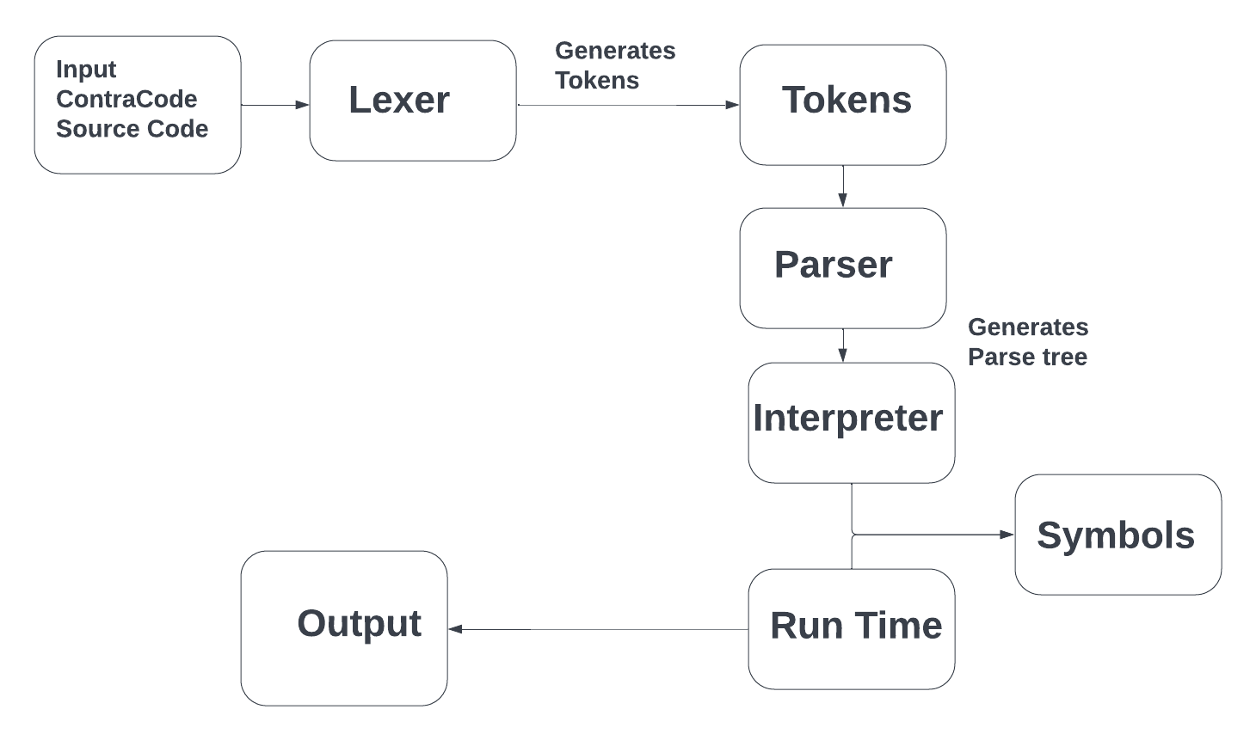
ARCHITECTURE
.

Slide 8
SYNTAX
IF condition THEN
body,
else if condition THEN
body,
else
body
while condition THEN
body
For <identifier> EQUAL <start> TO <end> THEN
body

Slide 9
SYNTAX
VAR i= 10
IF (2+(4-6) == 0 THEN
VAR i = i + 12
ELIF 1+2 == 4 THEN
VAR i = i +5
ELSE
VAR i=0

Slide 10
STACK & TREES
Storing temporary variables
The parentheses can be checked and it will be helpful in the case of recursive functions
Combining program – program_end, if-endif, else-end_else, etc
As a data storage for the runtime file
Trees will be used to create the parse tree for the grammar defined. It will take the tokens and draw the parse tree

Slide 11
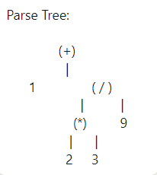
PARSE TREE
Example: 1 + 2 * 3/ 9
Result: (INT:1, PLUS, ((INT:2, MUL, INT:3), DIV, INT:9))

Slide 12
Contra Code Sample 1
contracode > VAR i = 2
[KEYWORD:VAR, IDENTIFIER:i, EQ, INT:2, EOF]
<basic.VarAssignNode object at 0x7fe8f01e74c0>
2
contracode > VAR i = i + (2-3/7)*7
[KEYWORD:VAR, IDENTIFIER:i, EQ, IDENTIFIER:i, PLUS, LPAREN, INT:2, MINUS, INT:3, DIV, INT:7, RPAREN, MUL, INT:7, EOF]
<basic.VarAssignNode object at 0x7fe8f01e7fd0>
13.0

Slide 13
Contra Code Sample 2
contracode > VAR i = i ^2
[KEYWORD:VAR, IDENTIFIER:i, EQ, IDENTIFIER:i, POW, INT:2, EOF]
<basic.VarAssignNode object at 0x7fe8f01e7430>
169.0

Slide 14
Contra Code Sample 3
contracode > VAR j = 1
[KEYWORD:VAR, IDENTIFIER:j, EQ, INT:1, EOF]
<basic.VarAssignNode object at 0x7fe8f01e7700>
1
contracode > IF j == 1 THEN VAR x= 0 ELSE VAR x=1
[KEYWORD:IF, IDENTIFIER:j, EE, INT:1, KEYWORD:THEN, KEYWORD:VAR, IDENTIFIER:x, EQ, INT, KEYWORD:ELSE, KEYWORD:VAR, IDENTIFIER:x, EQ, INT:1, EOF]
<basic.IfNode object at 0x7fe8f01f3370>
0

Slide 15
Contra Code Sample 4
contracode > VAR z= 0
[KEYWORD:VAR, IDENTIFIER:z, EQ, INT, EOF]
<basic.VarAssignNode object at 0x7fe8f01e75b0>
0
contracode > VAR x = 2
[KEYWORD:VAR, IDENTIFIER:x, EQ, INT:2, EOF]
<basic.VarAssignNode object at 0x7fe8f01e7f40>
2
contracode > IF x-2 <= z THEN VAR x= x + 2 ELIF x-1 < z THEN VAR x= x+1 ELSE VAR x=0
[KEYWORD:IF, IDENTIFIER:x, MINUS, INT:2, LTE, IDENTIFIER:z, KEYWORD:THEN, KEYWORD:VAR, IDENTIFIER:x, EQ, IDENTIFIER:x, PLUS, INT:2, KEYWORD:ELIF, IDENTIFIER:x, MINUS, INT:1, LT, IDENTIFIER:z, KEYWORD:THEN, KEYWORD:VAR, IDENTIFIER:x, EQ, IDENTIFIER:x, PLUS, INT:1, KEYWORD:ELSE, KEYWORD:VAR, IDENTIFIER:x, EQ, INT, EOF]
<basic.IfNode object at 0x7fe8f0225d00>
4

Slide 16
Contra Code Sample 5
contracode > FOR j = 0 TO 3 THEN VAR x = x +4
[KEYWORD:FOR, IDENTIFIER:j, EQ, INT, KEYWORD:TO, INT:3, KEYWORD:THEN, KEYWORD:VAR, IDENTIFIER:x, EQ, IDENTIFIER:x, PLUS, INT:4, EOF]
<basic.ForNode object at 0x7fe8f01f33d0>
contracode > x
[IDENTIFIER:x, EOF]
<basic.VarAccessNode object at 0x7fe8f01e7940>
16

Slide 17
CONCLUSION AND FUTURE WORK
In our approach, we have implemented the structure of language,operators, grammer, syntax, and basic data structures
In future, the following can be implemented to contra code:
Advanced Data Structures
Recursion & Multi-threading
User Defined Data types
Import Multiple files and functions
Improving the performance of compiled code by applying classical optimizations.

Slide 18
Thank You!
Team 32

